Slide 1

World population data analysis
-BY GAGANA.R

Slide 2

AGENDA
AGENDA
DATASET OVERVIEW
DATA CLEANING
DATA MODELING
DATA ANALYSIS
WORLD POPULATION DATA ANALYSIS

Slide 3

DATASET OVERVIEW
THE DATASET CONSISTS OF THREE TABLES, WITH TWO OF THEM SHARING THE SAME COLUMN STRUCTURE.
TABLE 1 CONTAINS DATA FROM THE YEARS 2001-2050.
TABLE 2 CONTAINS DATA FROM THE YEARS 2051-2010.
THESE TWO TABLES REPRESENT THE MALE AND FEMLAE POPULATIONS WORLDWIDE, CATEGORIZED BY AGE GROUP AND COUNTRIES.

Slide 4
DATA cleaning
WE USED POWERBI FOR VISUALIZATION IN DATA ANALYSIS.
STEPS FOLLOWED FOR DATA CLEANING IN DONE AT POWER QUERY EDITOR:
EXPELL THE NULL VALUES
REMOVING IRRELEVANT ROWS AND COLUMNS
USING ROUND FUNCTIONS
USING PIVOT TABLES
RENAMING VALUES

Slide 5
DATA MODELING
It is a process of creating a structured representation of data and it’s relationships to support storage, retrieval, and management in a database system. It involves defining how data is organized, what types of data is stored and how different data elements relate to each other.
The FactPopulation serves as fact table, whereas DimAge and DimRegion serves as Dimensional table.

Slide 6
Data analysis
After analyzing the data, we find that:
POPULATION- 943 BILLION
NUMBER OF COUNTRIES- 194

Slide 7
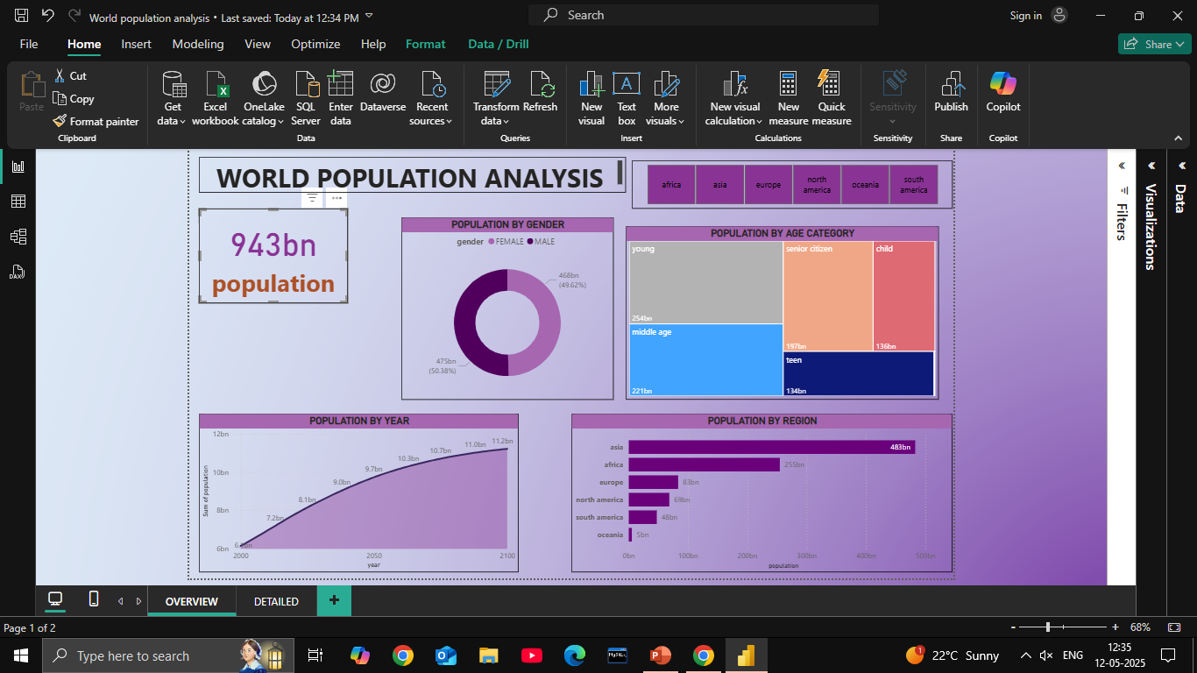
WHAT IS THE COMPOSITION OF MALE AND FEMALE POPULATION WORLDWIDE?
ACROSS THE WORLD, THE MALE AND FEMALE POPULATIONS ARE DISTRIBUTED ALMOST EQUALLY, WITH ONLY SLIGHT VARIATIONS.

Slide 8
WHICH REGION IS HIGHLY POPULATED?
AMONG ALL THE REGIONS, ASIA IS THE MOST POPULATED, FOLLOWED BY AFRICA IN SECOND PLACE, WHILE OCEANIA
IS THE LEAST POPULATED.

Slide 9
WHICH AGE GROUP HAS THE HIGHEST POPULATION?
YOUNG PEOPLE IS THE MOST POPULATED CATEGORY WITH 254 BILLION POPULATION.
THE SECOND HIGHEST POPULATED CATEGORY IS MIDDLE AGE WITH 221 BILLION POPULATION.
LASTLY, THE TEEN CATEGORY HAS THE LEAST POPULATION WITH 134 BILLION POPULATION.

Slide 10
WHAT IS THE POPULATION OVER THE YEARS?
THE POPULATION HAS BEEN STEADILY INCREASING OVER THE YEARS.

Slide 12
RECOMMENDATIONS:
TO REDUCE POPULATION GROWTH IN ASIA, KEY STRATEGIES INCLUDE-
Improving access to family planning, education and healthcare to lower infant mortality.
Government could promote smaller families through incentives and support later marriage and childbearing.

Slide 13
recommendations-
TO INCREASE POPULATION IN EUROPE, KEY STRATEGIES INCLUDE-
POLICIES TO ATTRACT IMMIGRATES AND SUPPORT THE INTEGRATION, ALONG WITH FLEXIBLE WORK ARRANGEMENTS, CAN HELP BOOST POPULATION.
ENCOURAGING WORK-LIFE BALANCE, PROMOTING GENDER QUALITY AND FERTILITY TREATMENTS ARE ALSO IMPORTANT.

Slide 14

THANK YOU

